Slide 1
Estimated Payment Date
David Chi
2016-07-18

Slide 2
Outline
Invoice Payment Cycle
Forecasting Future Payment Date
Populating Data for Supplier Collaboration tool

Slide 3
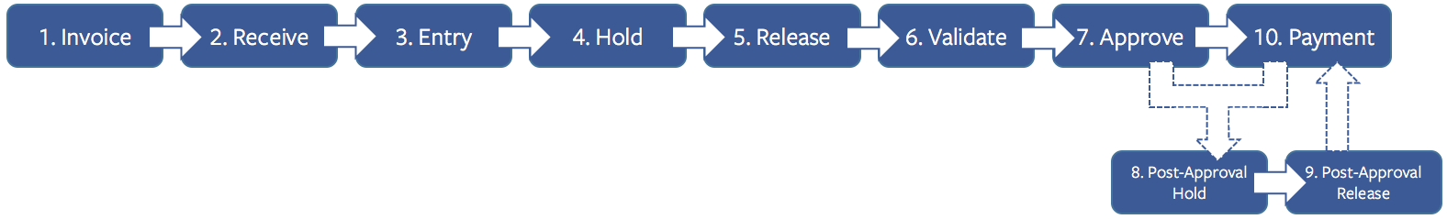
Invoice Payment
Invoices follow a multi-step process.
Median cycle times for each step (days):
Average invoice does not go on hold.

Slide 4
Forecasting Future Payment Date
Any given invoice will have data up to the last step it has completed.
Forecast payment date based on existing data.
Sample Data:

Slide 5
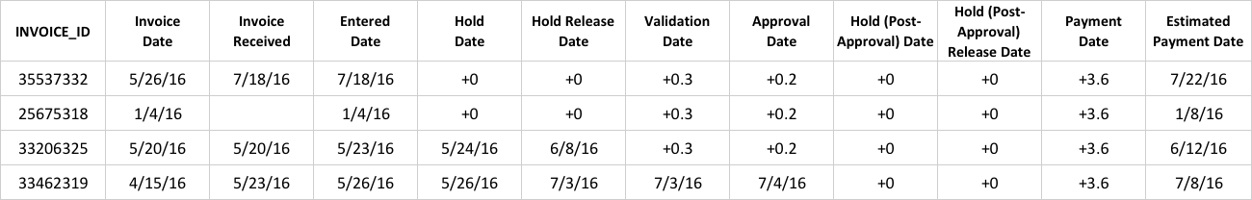
Forecasting Future Payment Date
Zeroth-order forecast:
Take the last milestone completed and add the median times for the remaining steps.

Slide 6
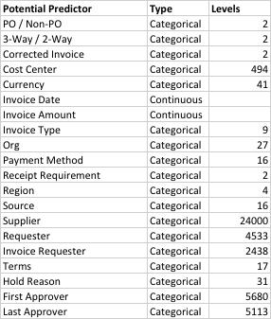
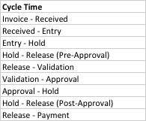

Modeling Cycle Times
Use other invoice data to more accurately predict each cycle time.
For predictors with high number of levels, convert to number of invoices per year.
This places levels with similar number of invoices processed close to each other on a continuous scale.

Slide 7
Modeling Cycle Times
Methodology for Modeling Cycle Time
Read invoice data into R.
Filter rows that have incomplete data for the Cycle Time being modeled.
Filter outliers in Cycle Time
Create training and test data sets
Fit Decision Trees to training data
Regression Tree
Bagging
Random Forests
Boosting
Test Model on test data
Repeat for all Cycle Times

Slide 8
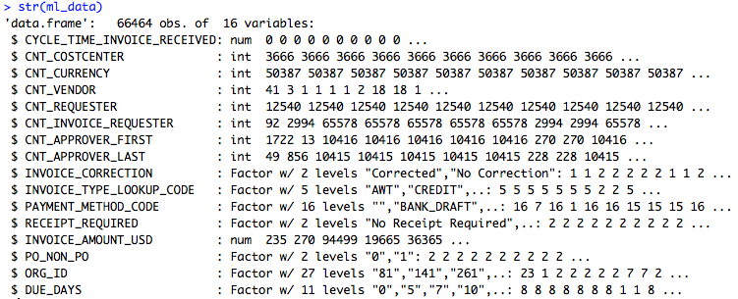
Modeling Cycle Times
Response
Predictors
Decision Tree
Recursive binary splitting maximizing reduction in impurity at each step.
Will tend to overfit.
Bagging
Build separate decision tree models based on different training sets and then average the models.
Will weight strong predictors.
Random Forest
Decorrelate bagged trees by limiting predictors that can be used in each bag.
Boosting
Sequence of simple trees where each successive tree is built for the residuals of the preceding tree.

Slide 9
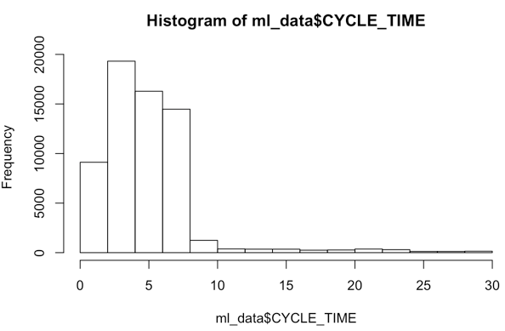
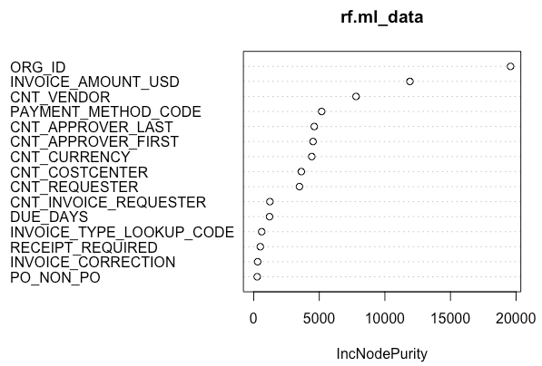
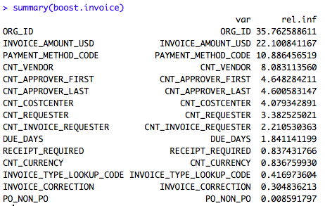
Modeling Cycle Times
Example: Cycle Time – Approval to Payment
Prep data
Split data into training and test sets
Model data using
Decision Tree, Bagging, Random Forests, Boosting
Calculate training and test MSE for each model
Select best model
Random Forests
Boosting

Slide 10
Modeling Cycle Times
Simple Decision Tree using most important predictors
ORG_ID
INVOICE_AMOUNT_USD
PAYMENT_METHOD_CODE
CNT_VENDOR
tree.invoice=tree(CYCLE_TIME~ORG_ID+INVOICE_AMOUNT_USD+PAYMENT_METHOD_CODE+CNT_VENDOR,ml_data, subset=train, control=tree.control(nrow(ml_data)/2, mincut = 5, minsize = 10, mindev = 0.001))

Slide 11
Populating Estimated Payment Date
Estimating Invoice Payment Date for unpaid invoices
Query all unpaid invoices with predictor values from Oracle
For each invoice forecast each remaining cycle time using selected model in R
Sum remaining cycle times to get estimated payment date
Write to table XXFB.XXFB_SC_INV_ESTPAYDATE from R
Include actual estimate, adjusted estimate, confidence interval
Include metadata (model version, created date)
Save previous estimates to XXFB.XXFB_SC_INV_ESTPAYDATE_ARCHIVE
Improving forecast
Compare previous estimates with actual payment date
Update forecast model based on recent data
Test other algorithms (neural net)
Supplier Onboarding
Supplier Onboarding also follows a multi-step process
Forecast supplier onboard date using similar framework

Slide 12
Populating Estimated Payment Date
Execution Plan
Create models for all cycle times
Calculate confidence intervals for all cycle times
Execute SQL query against Oracle in R
Pull unpaid invoice data into R
Create data frame for all invoices, future cycle times, estimated payment dates
Add “reported estimated payment date”, confidence interval
Execute SQL query against Oracle in R
Update archive table
Truncate active table
Update active table

